Slide 1
Learning Objective
I will be able to determine acceleration from displacement functions
Success Criteria
At the end of the lesson, I will be able to:
Apply the concept of the second derivative as the rate of change of the first derivative function
Identify acceleration as the second derivative of position with respect to time
Determine acceleration from displacement functions

Slide 2
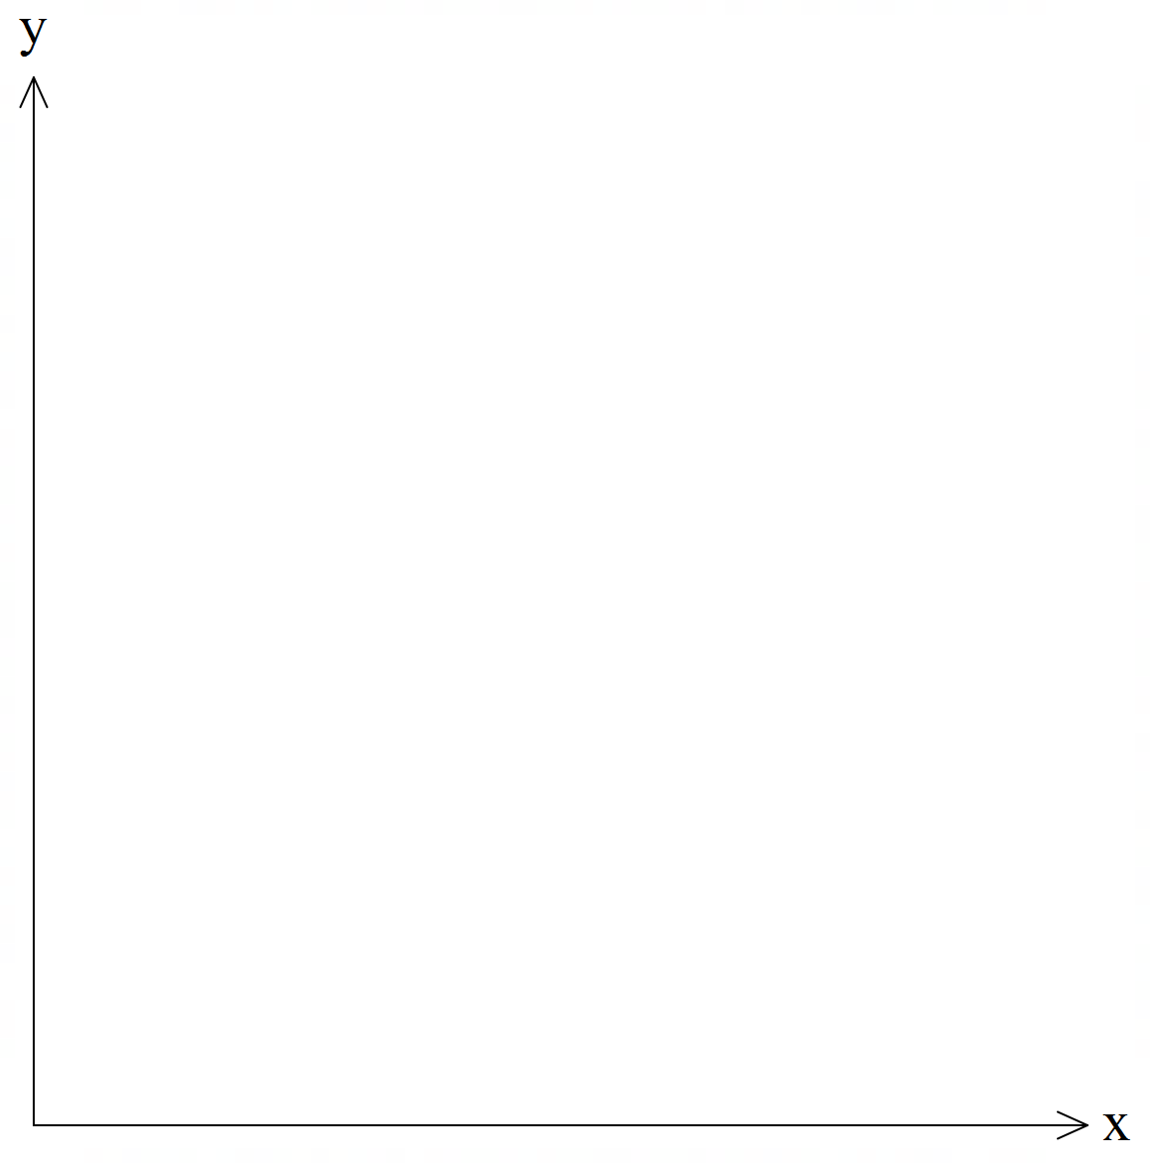
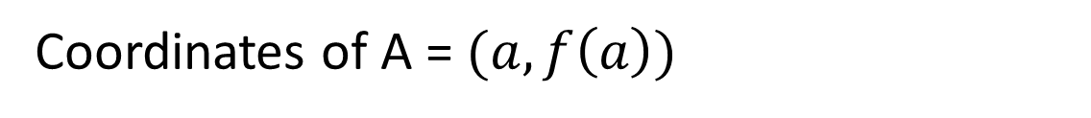



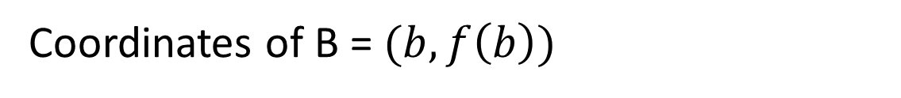

Average rate of change for a function
Activating Prior Knowledge
For any function $y=f(x)$ which passes through the interval $a≤x≤b$
B
Coordinates of A = $(a,f\left(a\right))$
$$(b,f(ba)$$
A
Coordinates of B = $(b,f\left(b\right))$
$$(a,f\left(a\right))$$
Rate of change$=\frac{f\left(b\right)−f\left(a\right)}{b−a}$

Slide 3
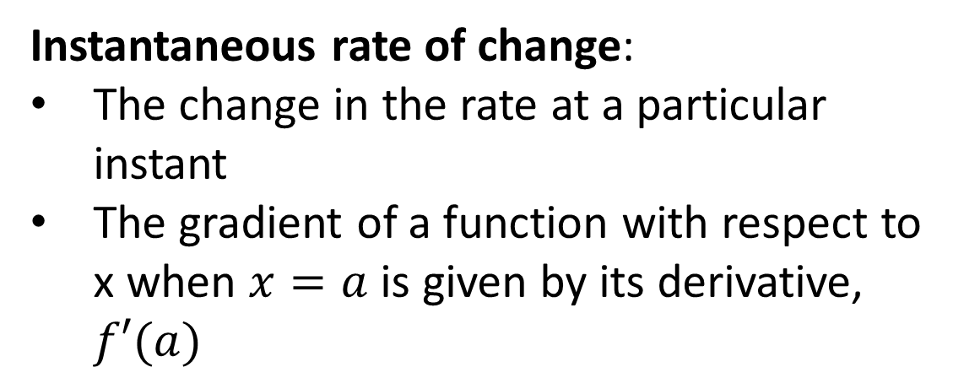
Instantaneous rate of change
Activating Prior knowledge
Instantaneous rate of change:
The change in the rate at a particular instant
The gradient of a function with respect to x when $x=a$ is given by its derivative, $f′(a)$
A

Slide 4



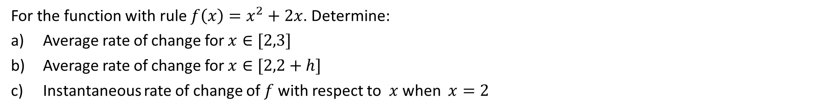






Guided Practice (Recap – To be reviewed at own time)
For the function with rule $f\left(x\right)=x^{2}+2x$. Determine:
Average rate of change for $x∈[2,3]$
Average rate of change for $x∈[2,2+h]$
Instantaneous rate of change of $f$ with respect to $x$ when $x=2$
a) Average rate of change $=\frac{f\left(3\right)−f(2)}{3−2}$
c) $f^{′}\left(x\right)=2x+2$
$$=\frac{9+6−(4+4)}{1}$$
$f^{′}\left(2\right)=6$
$$=7$$
b) Average rate of change $=\frac{f\left(2+h\right)−f(2)}{2+h−2}$
$$=\frac{{\left(2+h\right)}^{2}+2\left(2+h\right)−8}{h}$$
$$=\frac{4+4h+h^{2}+4+2h−8}{h}$$
$$=\frac{4h+h^{2}}{h}$$
$$=6+h$$

Slide 5
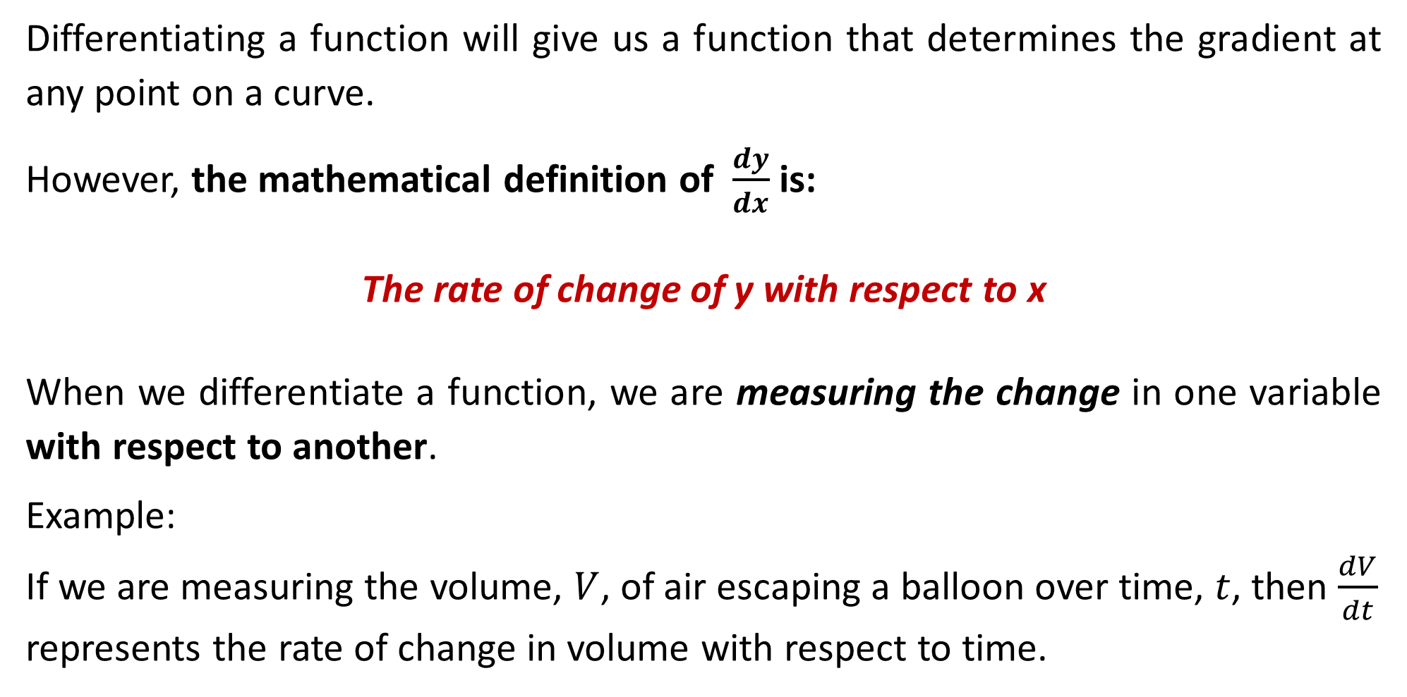
Rates of Change
Differentiating a function will give us a function that determines the gradient at any point on a curve.
However, the mathematical definition of $\frac{dy}{dx}$ is:
The rate of change of y with respect to x
When we differentiate a function, we are measuring the change in one variable with respect to another.
Example: If we are measuring the volume, $V$, of air escaping a balloon over time, $t$, then $\frac{dV}{dt}$ represents the rate of change in volume with respect to time.

Slide 6
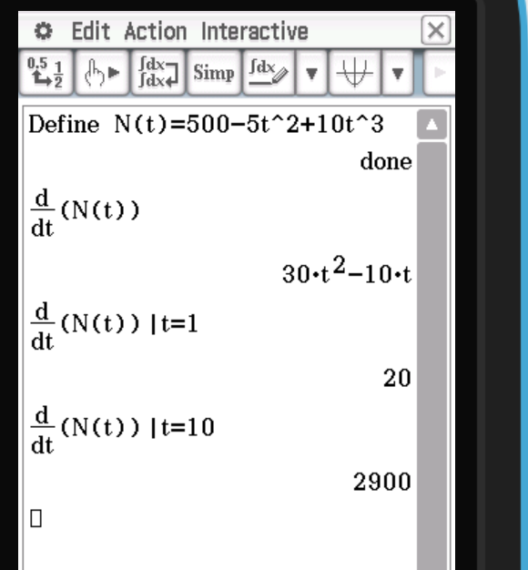
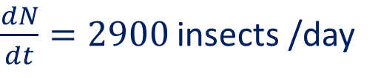

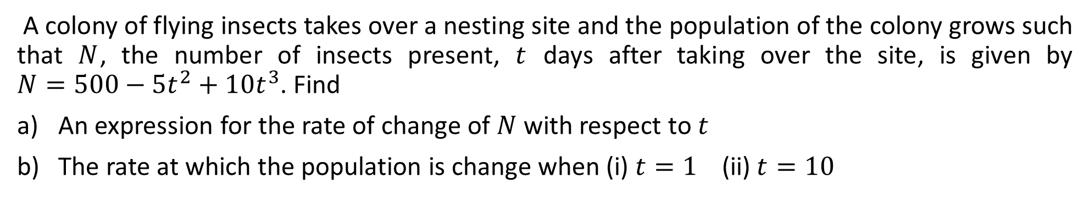
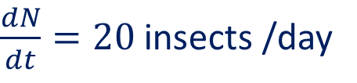
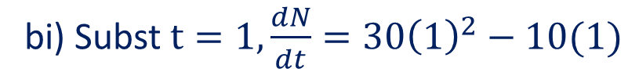
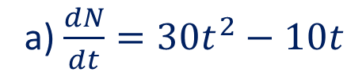
Guided Practice
A colony of flying insects takes over a nesting site and the population of the colony grows such that $N$, the number of insects present, $t$ days after taking over the site, is given by $N=500−5t^{2}+10t^{3}$. Find
An expression for the rate of change of $N$ with respect to $t$
The rate at which the population is change when (i) $t=1 \text{(}\text{ii}\text{) }t=10$
a) $\frac{dN}{dt}=30t^{2}−10t$
bi) Subst $t=1, \frac{dN}{dt}=30{\left(1\right)}^{2}−10(1)$
$\frac{dN}{dt}=20$ insects /day
bii) Subst $t=10, \frac{dN}{dt}=30{\left(10\right)}^{2}−10(10)$
$\frac{dN}{dt}=2900$ insects /day

Slide 7
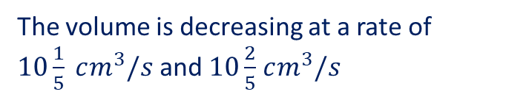


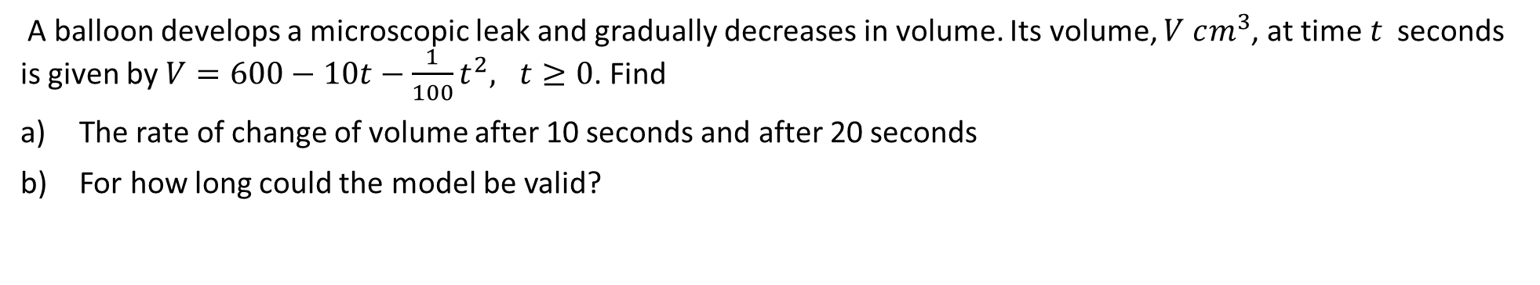







Guided Practice
A balloon develops a microscopic leak and gradually decreases in volume. Its volume, $V cm^{3}$, at time $t$ seconds is given by $V=600−10t−\frac{1}{100}t^{2}, t≥0$. Find
The rate of change of volume after 10 seconds and after 20 seconds
For how long could the model be valid?
a) $\frac{dV}{dt}=−10−\frac{1}{50}t$
b)The model will not be valid when $V<0$
Sub. $t=10,\frac{dv}{dt}=−10−\frac{1}{50}\left(10\right)$
Consider $V=0, 600−10t−\frac{1}{100}t^{2}=0$
$$\frac{dv}{dt}=−10\frac{1}{5}$$
Using Classpad to solve,
$$t=−500±100\sqrt{31}$$
Sub. $t=20,\frac{dv}{dt}=−10−\frac{1}{50}\left(20\right)$
$$\frac{dv}{dt}=−10\frac{2}{5}$$
$$∵t≥0,$$
The model may only be suitable for $0≤t≤100\sqrt{31}−500,$
The volume is decreasing at a rate of $10\frac{1}{5} cm^{3}/s$ and $10\frac{2}{5}$ $cm^{3}/s$

Slide 8





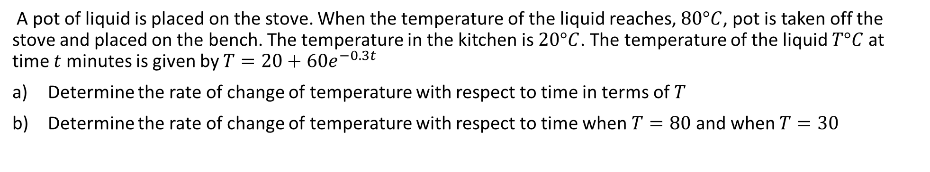
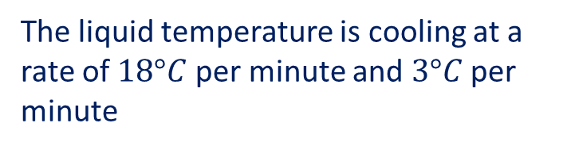




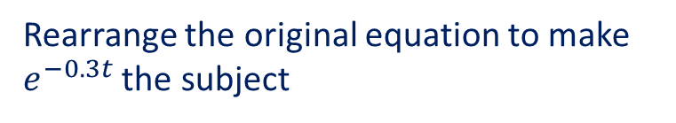


Guided Practice
A pot of liquid is placed on the stove. When the temperature of the liquid reaches, $80°C$, pot is taken off the stove and placed on the bench. The temperature in the kitchen is $20°C$. The temperature of the liquid $T°C$ at time $t$ minutes is given by $T=20+60e^{−0.3t}$
Determine the rate of change of temperature with respect to time in terms of $T$
Determine the rate of change of temperature with respect to time when $T=80$ and when $T=30$
a) $\frac{dT}{dt}=−18e^{−0.3t}$
b) Sub. $T=80$ into $\frac{dT}{dt}, \frac{dT}{dt}=0.3(20−80)$
Rearrange the original equation to make $e^{−0.3t}$ the subject
$$=−18 °C per minute$$
Sub. $T=30$ into $\frac{dT}{dt}, \frac{dT}{dt}=0.3(20−30)$
$$60e^{−0.3t}=T−20$$
$$e^{−0.3t}=\frac{\left(T−20\right)}{60}$$
$$=−3 °C per minute$$
∴$\frac{dT}{dt}=−18\frac{\left(T−20\right)}{60}$
The liquid temperature is cooling at a rate of $18°C$per minute and $3°C$ per minute
$$=\frac{3(20−T)}{10}$$
$$=0.3(20−T)$$

Slide 9
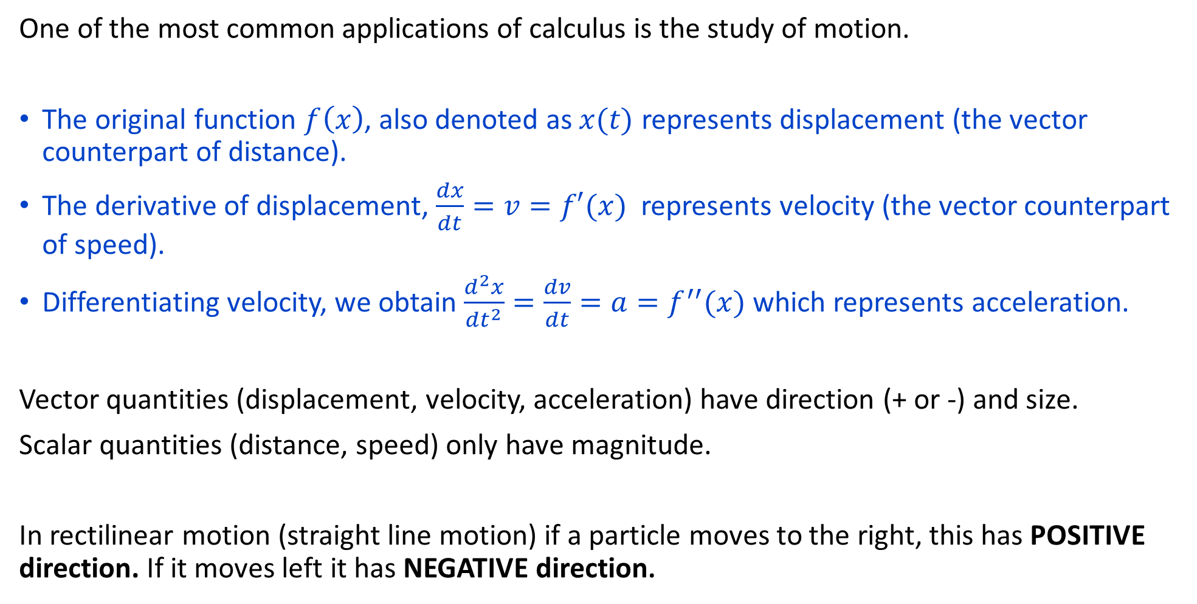
Applications of Motion
One of the most common applications of calculus is the study of motion.
The original function $f\left(x\right)$, also denoted as $x(t)$ represents displacement (the vector counterpart of distance).
The derivative of displacement, $\frac{dx}{dt}=v=f′(x)$ represents velocity (the vector counterpart of speed).
Differentiating velocity, we obtain $\frac{d^{2}x}{dt^{2}}=\frac{dv}{dt}=a=f^{′′}(x)$ which represents acceleration.
Vector quantities (displacement, velocity, acceleration) have direction (+ or -) and size.
Scalar quantities (distance, speed) only have magnitude.
In rectilinear motion (straight line motion) if a particle moves to the right, this has POSITIVE direction. If it moves left it has NEGATIVE direction.

Slide 10
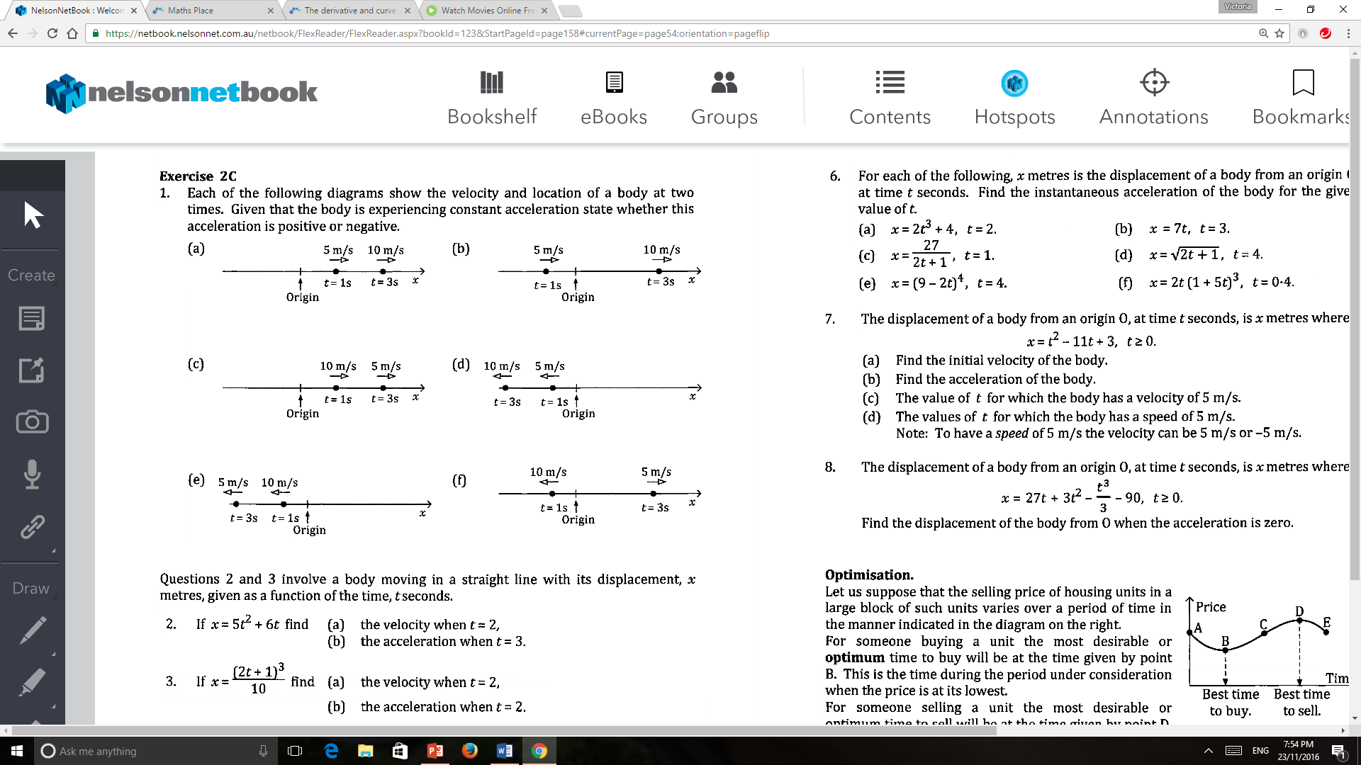
Guided Practice (Applications of Motion – Q1 from Sadler Ex 2C)
Acceleration is POSITIVE as the velocity increases in the positive direction.
Acceleration is POSITIVE – similar reasoning to above.
Acceleration is NEGATIVE as we are decreasing the velocity in the positive direction.
Acceleration is NEGATIVE as we decreasing the velocity from 5m/s in the negative direction to 10m/s in the negative direction.
Acceleration is POSITIVE as we are increasing the velocity from 10m/s in the negative direction to 5m/s in the negative direction.
Acceleration is POSITIVE because at t = 1, the velocity is negative but at t = 3, the velocity is now positive.

Slide 11
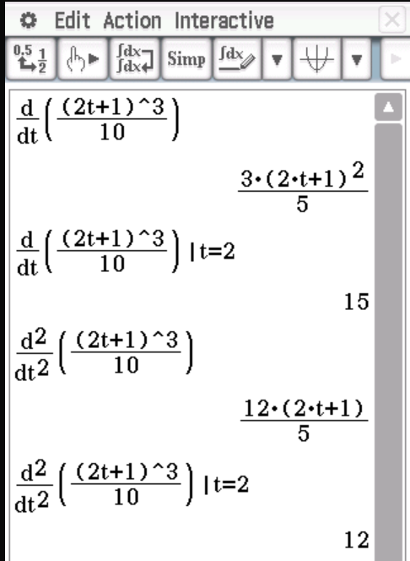
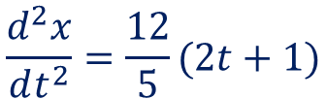

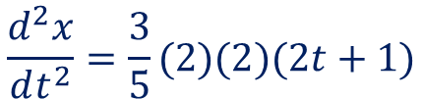
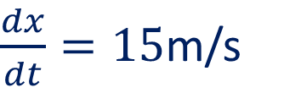
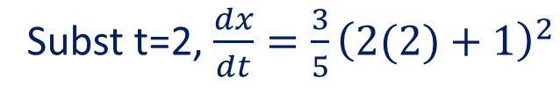


Guided Practice
If $x=\frac{{\left(2t+1\right)}^{3}}{10}$ find the v$elocity and acceleration at t=2$
$$\frac{dx}{dt}=\frac{1}{10}\left(3\right)\left(2\right){\left(2t+1\right)}^{2}$$
$$\frac{dx}{dt}=\frac{3}{5}{\left(2t+1\right)}^{2}$$
Subst t=2, $\frac{dx}{dt}=\frac{3}{5}{\left(2(2)+1\right)}^{2}$
$\frac{dx}{dt}=15$m/s
$$\frac{d^{2}x}{dt^{2}}=\frac{3}{5}(2)(2)(2t+1)$$
$$\frac{d^{2}x}{dt^{2}}=\frac{12}{5}(2t+1)$$
Subst t=2 $\frac{d^{2}x}{dt^{2}}=\frac{12}{5}\left(2\left(2\right)+1\right)=12m^{2} /s$

Slide 12
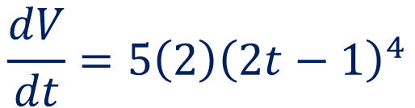

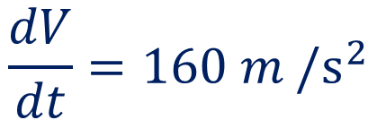
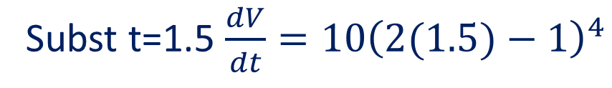
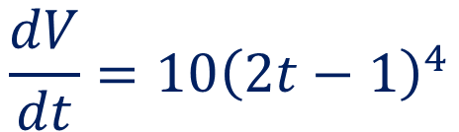
Guided Practice
If $v={\left(2t−1\right)}^{5}$ find the acceleration $t=1.5$
$$\frac{dV}{dt}=5\left(2\right){\left(2t−1\right)}^{4}$$
$$\frac{dV}{dt}=10{\left(2t−1\right)}^{4}$$
Subst t=1.5 $\frac{dV}{dt}=10{\left(2(1.5)−1\right)}^{4}$
$$\frac{dV}{dt}=160 m^{ }/s^{2}$$

Slide 13



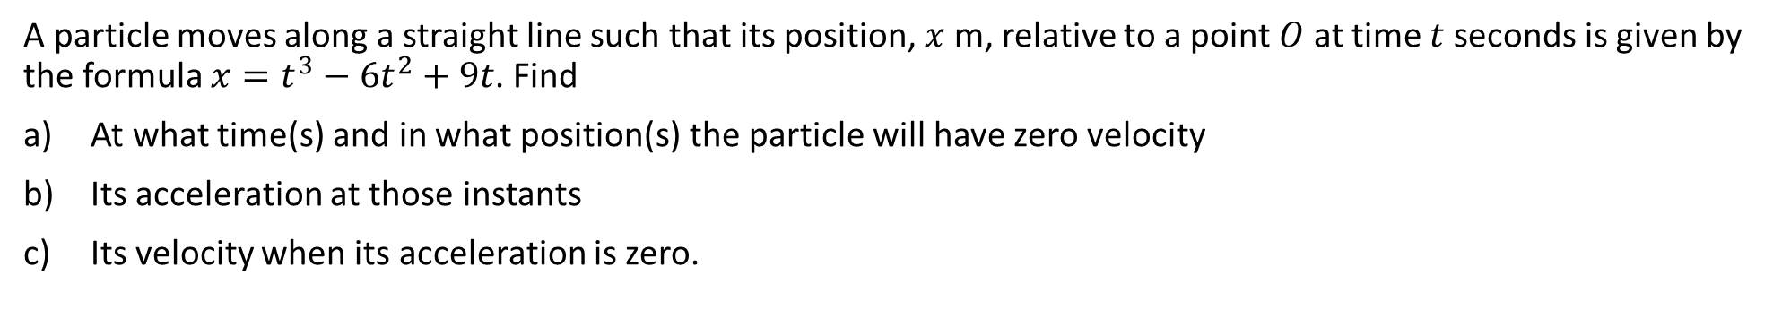






Guided Practice
A particle moves along a straight line such that its position, $x$ m, relative to a point $O$ at time $t$ seconds is given by the formula $x=t^{3}−6t^{2}+9t$. Find
At what time(s) and in what position(s) the particle will have zero velocity
Its acceleration at those instants
Its velocity when its acceleration is zero.
Acceleration: $a=\frac{dv}{dt}=6t−12$
$$v=\frac{dx}{dt}=3t^{2}−12t+9$$
Sub $t=1$ into $a,$ $a=−6 m/s^{2}$
Sub $t=3$ into $a,$ $a=6 m/s^{2}$
a) When $v=0, 3t^{2}−12t+9=0$
$${3(t}^{2}−4t+3)=0$$
c) Sub $a=0, 6t−12=0$
$$\left(t−1\right)\left(t−3\right)=0$$
$$t=2s$$
$$t=1s , t=3s$$
Sub $t=2$ into $v,$ $v=3{\left(2\right)}^{2}−12\left(2\right)+9=−3m/s^{ }$
Sub $t=1$ into $x,$ ${\left(1\right)}^{3}−6{\left(1\right)}^{2}+9(1)=4 m$
Sub $t=3$ into $x,$ ${\left(3\right)}^{3}−6{\left(3\right)}^{2}+9(3)=0 m$
At time $t=1s , t=3s$ will the particle have 0 velocity and will be at positions $x=4$ and $x=0$ respecitvely

Slide 14
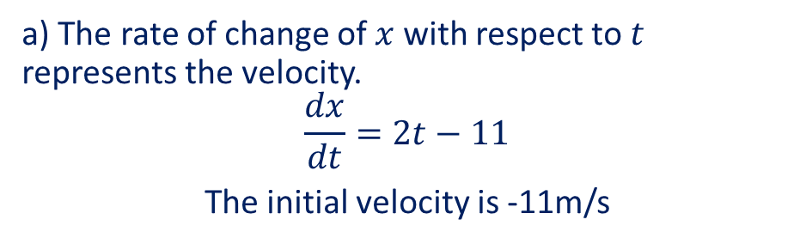
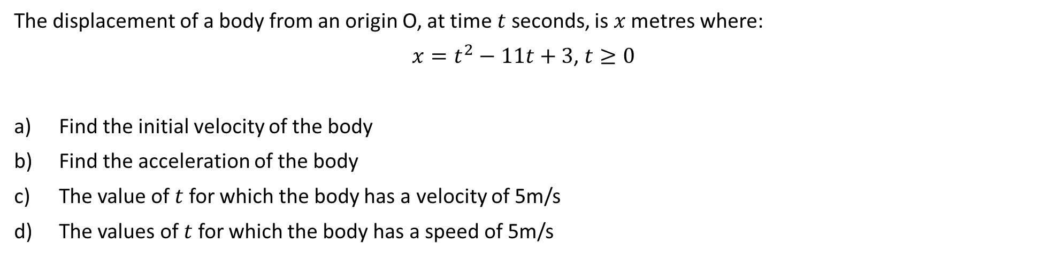
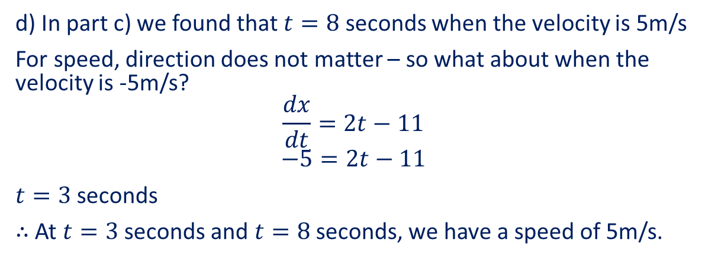
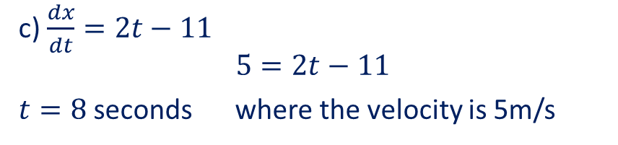
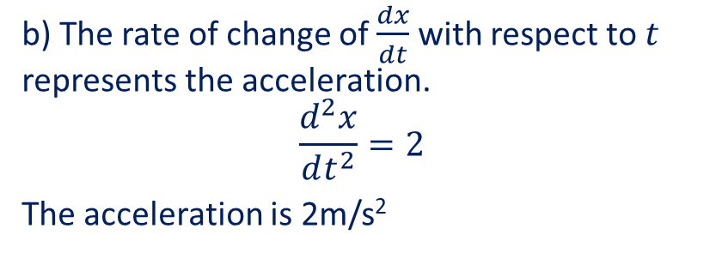
Guided Practice
The displacement of a body from an origin O, at time $t$ seconds, is $x$ metres where:
$x=t^{2}−11t+3$, $t≥0$
Find the initial velocity of the body
Find the acceleration of the body
The value of $t$ for which the body has a velocity of 5m/s
The values of $t$ for which the body has a speed of 5m/s
c) $\frac{dx}{dt}=2t−11$
$$5=2t−11$$
$t=8$ seconds where the velocity is 5m/s
a) The rate of change of $x$ with respect to $t$ represents the velocity.
$$\frac{dx}{dt}=2t−11$$
The initial velocity is -11m/s
d) In part c) we found that $t=8$ seconds when the velocity is 5m/s
For speed, direction does not matter – so what about when the velocity is -5m/s?
$$\frac{dx}{dt}=2t−11$$
$$−5=2t−11$$
$t=3$ seconds
$∴$ At $t=3$ seconds and $t=8$ seconds, we have a speed of 5m/s.
b) The rate of change of $\frac{dx}{dt}$ with respect to $t$ represents the acceleration.
$$\frac{d^{2}x}{dt^{2}}=2$$
The acceleration is 2m/s²

Slide 15







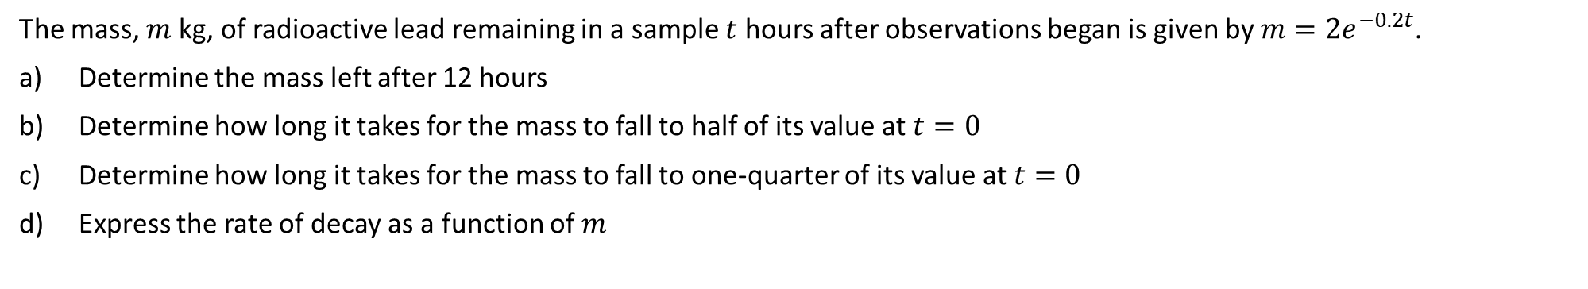










Guided Practice
The mass, $m$ kg, of radioactive lead remaining in a sample $t$ hours after observations began is given by $m=2e^{−0.2t}$.
Determine the mass left after 12 hours
Determine how long it takes for the mass to fall to half of its value at $t=0$
Determine how long it takes for the mass to fall to one-quarter of its value at $t=0$
Express the rate of decay as a function of $m$
c) one-quarter its mass, $m=\frac{1}{2} kg$
a) Sub $t=12,$ into $m$
Sub $m=\frac{1}{2}$ into $m$
$$m=0.18 kg (2 d.p)$$
$$\frac{1}{2}=2e^{−0.2t}$$
b) Sub $t=0,$ into $m$
Initial mass, $m=2 kg$
$$t=6.93 hours$$
Half its mass, $m=1 kg$
d) $\frac{dm}{dt}=−0.4 e^{−0.2t}$
Sub $m=1$ into $m$
Express original function in terms of m,
$$e^{−0.2t}=\frac{m}{2}$$
$$1=2e^{−0.2t}$$
$$\frac{dm}{dt}=−0.4\frac{m}{2}=−0.2m$$
$$Solve(1=2e^{−0.2t}, t$$
$$t=3.47 hours$$
Rate of decay is $0.2m$

Slide 16
Independent Practice
Complete Cambridge Ex 5B

